Slide 1


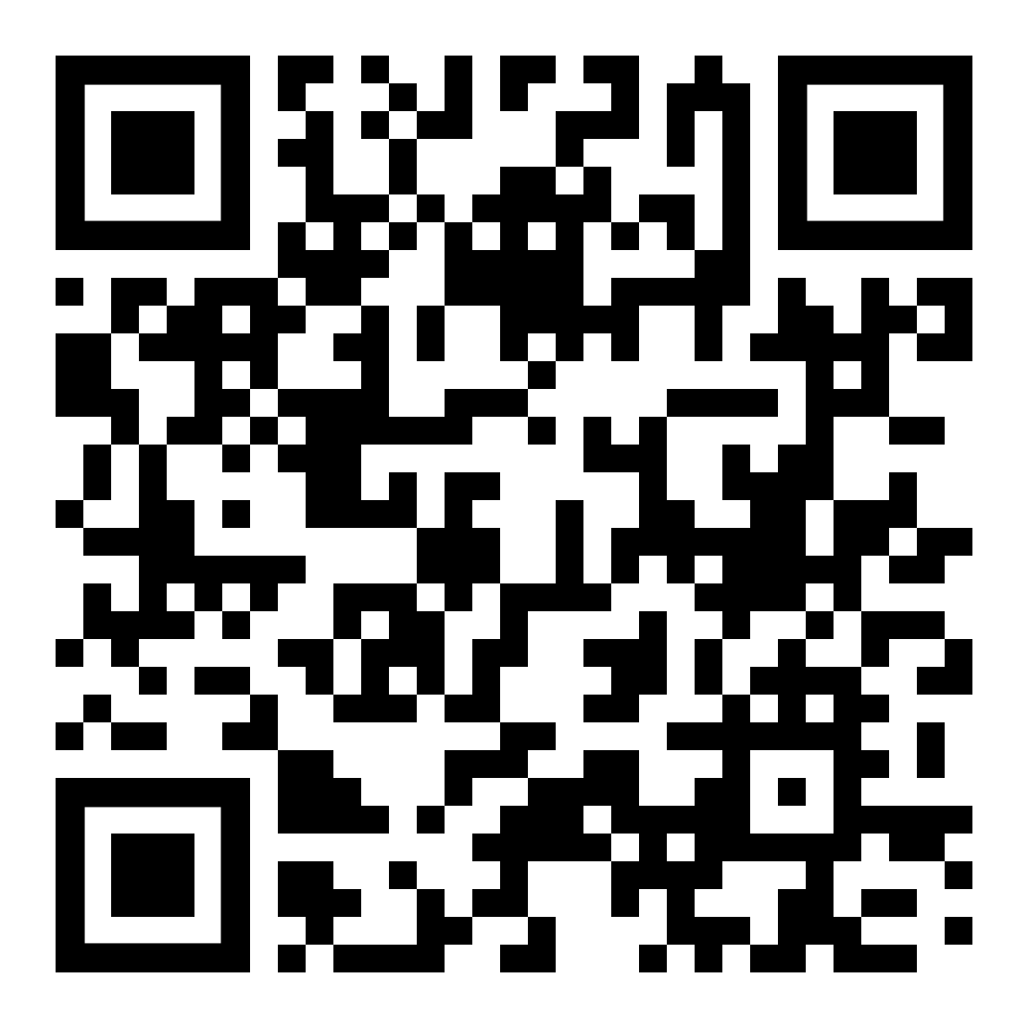
Building Assembly Lines in Temporal
Link to Talk & Sample Code

Slide 2



Introductions
Robert Ward
Co-founder / Principal Architect @ Juristat
Co-founder @ Arch Reactor Hackerspace
Juristat
Mission: Data-driven solutions to improve patent outcomes
What if obtaining a patent was faster, easier, and more predictable?
Started in 2012 as an Patent Analytics product
Expanded in 2019 to Workflow Automation
Works with ⅓ of the top 100 patent law firms, and tech giants like Taiwan Semiconductor Manufacturing and Lenovo

Slide 3
What is Workflow Automation?
Helping patent attorneys work better and faster, with fewer errors:
Collect research materials
Prepare document boilerplate
Annotate documents
Handle basic communications
Minimize repetitive data entry
Apply consistent file naming and formatting
Notes:
A workflow in Juristat context is a set of steps to prepare some materials for an attorney, not a Temporal workflow
Workflow automation might mean helping to respond to a rejection or filling out some forms

Slide 4



The Problem
Inputs and prep work from automated systems
Highly trained analyst doing end-to-end work
Finished product ready to send to a client
Notes:
We have a bunch of automated systems that do all sorts of things.
Document fetching
Parsing
Compiling data
Building reports
etc.
Then we hand the results of all that work off to a person who does the finishing touches and hands it off to the client
This means that our analysts need lots of training to do every single part of the process
It also means we can’t use the results of that analyst work in automated systems

Slide 5

The Solution: Assembly Lines
Final human quality review before sending to a client
Inputs and prep work from automated systems
Mixed workflow of small human tasks and automated systems
Notes:
The Assembly Line
Human and automated workers working together
Small human tasks
Not every person needs to be trained on the whole process
Less overhead for changing workflows

Slide 6
Solution Goals
Define the whole workflow process end-to-end in code
Make it easy to call a human task
Small, reusable human tasks
Parallelize work where possible
Handle deduplication
Don’t re-do work

Slide 7

High Level Design
Human Tasks
Database
Submit
Task Activity
Task Complete Signal
Temporal Workflows
Human Tasks
API
Human Tasks
Frontend
Notes:
This is the general architecture of the system
Your inputs to the human task will go through an activity into a database
The outputs from the human task will come back through a signal

Slide 8
Temporal Workflows
Parent Workflow
Human Task Workflow
Do Human Task Workflow
Notes:
Three level model:
Parent workflow, where the actual high level workflow is defined
A unique child workflow
A single workflow where the task actually happens, deduplicated and memoized

Slide 9

Sample Workflow

Slide 10
Add Digits Together
A very pointless workflow that…
Accepts a string as input
Extracts all the digits from the input string
Asks a person to add the digits together
Returns the sum
Notes:
This is a contrived example to demonstrate our created workflow.
The code I’m going to show off is not exactly what’s in the repo, but there is a full working example in there.

Slide 11
High Level Design
Human Tasks
Database
Submit
Task Activity
Task Complete Signal
Temporal Workflows
Human Tasks
API
Human Tasks
Frontend
Temporal Workflows & Activities
Notes:
First I’m going to talk about the temporal side
Fair warning, there’s not going to be as much detail about the API and frontend sections, because it’ll vary so much on your individual requirements

Slide 12
Temporal Workflows
Parent Workflow
Human Task Workflow
Do Human Task Workflow
Notes:
Three level model:
Parent workflow, where the actual high level workflow is defined
A human task workflow with a generated unique workflow ID
A single workflow where the task actually happens, deduplicated and memoized

Slide 13
Temporal Workflows
Where your actual workflow code lives
You need the result of a human task
Can call a human task almost like a function
Parent Workflow
Notes:
The parent workflow is your actual Temporal workflow, where you’re orchestrating the work that needs to be done.
The goal of our system is to have a single function you can call to schedule a human task, validate the result, and get the output, just like any other activity.

Slide 14
Parent Workflow
export async function addDigitsInStringTogether(
input: string
): Promise<number> {
const digits = await getDigitsFromString(input);
const humanTaskResult = await addDigitsHumanTask({ digits });
return doubleNumber(humanTaskResult.sum);
}
Notes:
The parent workflow is your actual Temporal workflow, where you’re orchestrating the work that needs to be done.

Slide 15
Task Wrapper Function
export async function addDigitsHumanTask(
input: AddDigitsHumanTask["input"]
): Promise<AddDigitsHumanTask["output"]> {
const humanTaskResult = await executeChild(humanTask<AddDigitsHumanTask>, {
workflowId: `humanTask-${workflowInfo().workflowId}-add-digits-${uuid4()}`,
workflowRunTimeout: "7d",
args: ["add-digits", input],
});
return humanTaskResult;
}
Notes:
This is a wrapper function meant to be called directly from the parent workflow.
It takes care of submitting the human task correctly and giving type annotations to the input and output.
Makes a unique workflow ID for each call.
Sets options.

Slide 16
Temporal Workflows
Generate workflow IDs with a unique ID
Can be called from multiple workflows
Handles deduplication and routing of results
Human Task Workflow
Notes:
The human task workflow should be called with a unique ID.
The human task workflow is in charge of signal handling and deduplicating calls to process the same input.

Slide 17
Unique Child Workflow
export async function humanTask<Task extends HumanTask>(
type: Task["type"],
input: Task["input"]
): Promise<Task["output"]> {
let result: HumanTaskCompletedSignalPayload | undefined;
setHandler(humanTaskCompletedSignal, (paylaod) => { result = paylaod; });
await signalWithStartHumanTask(type, input);
await condition(() => result !== undefined);
if (result!.success) return result!.output as Task["output"];
else throw ApplicationFailure.fromError(result!.error);
}
Notes:
The unique child workflow can be called many times from many different parent workflows.
Each invocation should be done with a unique ID
The signalWithStartHumanTask activity will start the doHumanTask workflow and subscribe to its output.

Slide 18
Signal With Start Activity
export async function signalWithStartHumanTask(args: TaskInput): Promise<void>{
const workflowId = await getDeterministicWorkflowId(args)
const ctx = await Context.current()
const output = await db.getTaskResult(workflowId);
if (result) {
client.workflow
.getHandle(ctx.info.workflowExecution.workflowId)
.signal(humanTaskCompletedSignal, { success: true, output });
return;
}
…
}
Notes:
The signalWithStart activity must generate a unique and deterministic workflow ID from the task input
The workflow options are inherited from the parent workflow
The activity sends a signal to the possibly new workflow with it’s workflow ID, subscribing to the result of the human task

Slide 19
Signal With Start Activity
export async function signalWithStartHumanTask(args: TaskInput): Promise<void>{
…
await client.workflow.signalWithStart(doHumanTask, {
workflowId,
workflowRunTimeout: '7d',
taskQueue: ctx.info.taskQueue,
args: [args],
signal: subscribeToHumanTaskCompletedSignal,
signalArgs: [ctx.info.workflowExecution.workflowId],
})
}
Notes:
The signalWithStart activity must generate a unique and deterministic workflow ID from the task input
The workflow options are inherited from the parent workflow
The activity sends a signal to the possibly new workflow with it’s workflow ID, subscribing to the result of the human task

Slide 20
Temporal Workflows
Handles the actual human task interaction
Performs pre and post processing
Handles memoization of task results
Will only be called once for any given task
Do Human Task Workflow
Notes:
The doHumanTask workflow is where the actual human task work is done. It validates inputs and outputs, sends the task to our external system, handles the remote signal with the task result, and then sends out the results to all subscribed humanTask workflows.

Slide 21
Do Human Task Workflow
export async function doHumanTask(args: TaskInput): Promise<TaskOutput> {
const subscriptions = new Set<string>()
setHandler(subscribeToHumanTaskCompletedSignal, async ({ workflowId }) =>
subscriptions.add(workflowId)
)
let result = undefined
setHandler(externalHumanTaskCompletedSignal, (payload) => {
result = payload
})
// …
}
Notes:
The doHumanTask workflow is in charge of actually performing the task
Since we’re invoking it with signalWithStart, the tasks will be deduplicated, and multiple workflows can get the result of the same task
The first thing we do is set up our signal handlers.
The first one is gathering subscriptions for workflows which want the results of this task
The second is waiting for an external signal that the human task is complete

Slide 22
Do Human Task Workflow
export async function doHumanTask(args: TaskInput): Promise<TaskOutput> {
// …
try {
// …
await submitHumanTaskToExternalSystem(args)
await condition(() => result !== undefined)
// …
Notes:
If we don’t have a previous result, then we submit the task for human processing.
This takes the form of an API or database call
Lastly, we wait for a result from the external system. This will be set by the signal handler we declared earlier.

Slide 23
Do Human Task Workflow
export async function doHumanTask(args: TaskInput): Promise<TaskOutput> {
// …
try {
// …
if (result.error) throw error
await signalSuccess(subscriptions, result)
} catch (error) {
await signalError(subscriptions, error)
}
}
Notes:
Lastly we’ll handle any errors that have happened, do any post processing the task requires, then signal the subscribed workflows that the task is done.

Slide 24
Unique Child Workflow
export async function humanTask(args: TaskInput): Promise<TaskOutput> {
let result = undefined
setHandler(humanTaskCompletedSignal, (payload) => {
result = payload
})
await signalWithStartHumanTask(args)
await condition(() => result !== undefined)
if (result.success) return result.output
else throw result.error
}
Notes:
Now we’re back at the humanTask workflow.
Our signal handler will have been called with the result payload.
The condition will pass, and we’ll return either success or failure to the main workflow.

Slide 25
Parent Workflow
export async function addDigitsInStringTogether(
input: string
): Promise<number> {
const digits = await getDigitsFromString(input);
const humanTaskResult = await addDigitsHumanTask({ digits });
return doubleNumber(humanTaskResult.sum);
}
Notes:
The parent workflow now has the result of the human task.
We can perform further activities on the task just like it was the result of any activity.

Slide 26
High Level Design
Human Tasks
Database
Submit
Task Activity
Task Complete Signal
Temporal Workflows
Human Tasks
API
Human Tasks
Frontend
Human Task System
Notes:
The API portion of the task system will depend a lot more on your system design, so I won’t go into detail as much here.
There is a code sample in the repo if you’d like to see a very basic working example.

Slide 27
Tasks API
Start a Task
Heartbeat a Task
Complete a Task

Slide 28

Start a Task
In a transaction …
List available tasks
Self-assign the next one
Return the task input
Notes:
The logic on starting a task can be as complicated as you need it to be.
Fundamentally the goal is usually to find the next available task and take it.
You may also want to start a specific task.

Slide 29

Heartbeat a Task
At a set interval
Mark the task as still being worked on
Notes:
It’s important to keep track of what tasks are being worked on.
If someone starts a task, but doesn’t finish it, the heartbeat will keep track of if they’re continuing to work on it or if it’s been forgotten.

Slide 30

Complete a Task
In a transaction …
Mark the task as complete
Signal the workflow with the output
Notes:
Completing a task involves marking it as complete and then signaling the workflow that the task is done.

Slide 31
High Level Design
Human Tasks
Database
Submit
Task Activity
Task Complete Signal
Temporal Workflows
Human Tasks
API
Human Tasks
Frontend
Human Task System
Notes:
The API portion of the task system will depend a lot more on your system design, so I won’t go into detail as much here.
There is a code sample in the repo if you’d like to see a very basic working example.

Slide 32
Not even going to get into it…
Each task will need a dedicated frontend
Can be simple or complicated
Need to heartbeat while work is ongoing

Slide 33
Results?

Slide 34
Results!
Generating Citation Sheets
Documents parsed in hours instead of days
Reduced errors due to automation
Able to alter workflows in code instead of instructions

Slide 35
Future Projects - General
Switch to updates for all task interactions
Use data encoder / converter for all communications
Notes:
Switch to updates for all task interactions
No direct DB calls from API

Slide 36
Future Projects - Juristat
More workflows!
External / Anonymous assignees
Task reviews
Task training

Slide 37

Comments?
Questions?
Concerns?
https://github.com/rtward/temporal-assembly-line-talk

Slide 38
Robert Ward
robert@juristat.com
@rtward
https://github.com/rtward/temporal-assembly-line-talk

